Slide 1
Object Tracking

Slide 2
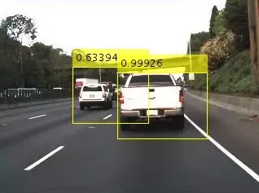
In computer vision, object detection is scanning and searching for an object in an image or a video (which is just sequence of images).
We are detecting cars from an image, this is referred as object detection.

Slide 3
Object Tracking is like you are spying on someone and following it. Done in motion images like in animated gifs or videos, we want to track how an object is moving, where is it going, or its speed.
There are two sets of ways to “track” an object.
First is when tracking is series of detection. Suppose in a video of moving traffic, I want to track a car or a person, I take different snapshots of the video, (images at different times by pausing the video) and detect my object, like a car or a person. Then, by checking how my object has moved in different frames of the video, I can track it. Like calculate its velocity, as I know how much it got displaced over two frames and what was time interval between them.
Because we are processing all the pixels of the video snap many times, these kind of algorithms come under dense method of tracking.
First kind of method is more like cheating, as actually we are not “tracking” but “detecting” it at different points of time. Improved method is “detection with dynamics”. Consider the same scenario, you wan to track a car on road, by checking it’s position at some time ‘t’ , we first try to estimate it where should it be at some other time, say, ‘t+5’. So, we are trying to estimate the car’s trajectory. Using our estimate, and the actual image of the car at t+5, we use different algorithms to track it.
As we are processing the pixels which are near to the area where we are estimating object to be, this is sparse method of tracking. Also, it is faster (processing of less pixels)

Slide 4
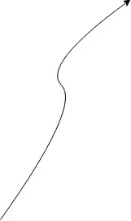
Using detection with dynamics, we sort of get a smoother curve as to where the object is moving, since, we are applying our estimates and common sense into tracking.

Slide 5

However, when we do tracking as only “series of detections”, we tend to get this kind of trajectory. As to where the object was at different points of time and kind of joining these points to know its trajectory.

Slide 6
Object Recognition :
Object recognition is the technique of identifying the object present in images and videos. It is one of the most important applications of machine learning and deep learning. The goal of this field is to teach machines to understand (recognize) the content of an image just like humans do.

Slide 7
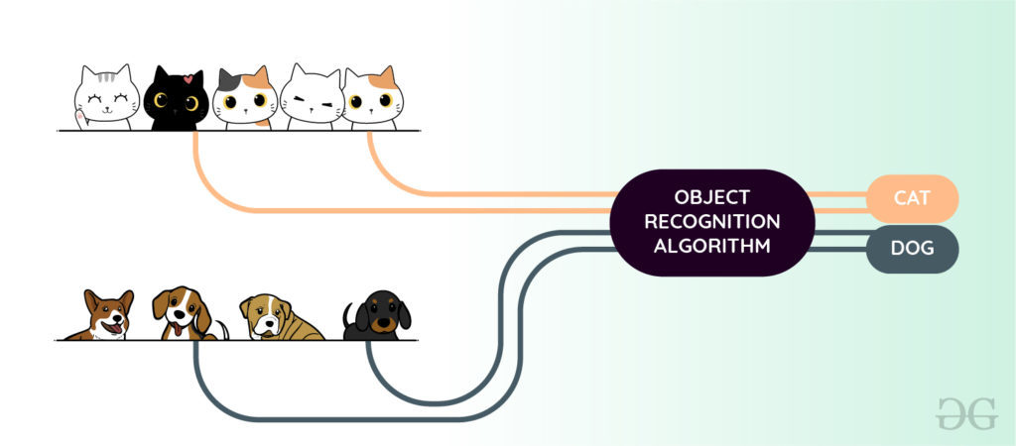

Slide 8
Object Recognition Using Machine Learning
HOG (Histogram of oriented Gradients) feature Extractor and SVM (Support Vector Machine) model: Before the era of deep learning, it was a state-of-the-art method for object detection. It takes histogram descriptors of both positive (those images which contain object) and negative(that image that does not contain objects) samples and trains our SVM model on that.
Bag of features model: Just like bag of words considers document as an orderless collection of words, this approach also represents an image as an orderless collection of image features. Examples of this are SIFT, MSER, etc.

Slide 9
Viola-Jones algorithm: This algorithm is widely used for face detection in the image or real-time. It performs Haar-like feature extraction from the image. This generates a large number of features. These features are then passed into a boosting classifier. This generates a cascade of the boosted classifier to perform image detection. An image needs to pass to each of the classifiers to generate a positive (face found) result. The advantage of Viola-Jones is that it has a detection time of 2 fps which can be used in a real-time face recognition system.

Slide 10
Object Recognition Using Deep Learning
Convolution Neural Network (CNN) is one of the most popular ways of doing object recognition. It is widely used and most state-of-the-art neural networks used this method for various object recognition related tasks such as image classification.
This CNN network takes an image as input and outputs the probability of the different classes. If the object present in the image then it’s output probability is high else the output probability of the rest of classes is either negligible or low. The advantage of Deep learning is that we don’t need to do feature extraction from data as compared to machine learning.

Slide 11
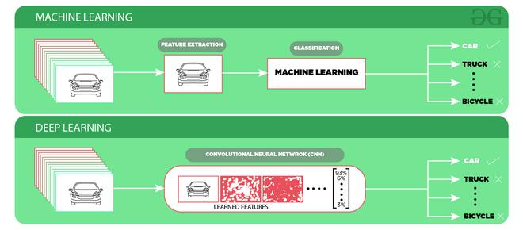

Slide 12
Challenges of Object Recognition:
Since we take the output generated by last (fully connected) layer of the CNN model is a single class label. So, a simple CNN approach will not work if more than one class labels are present in the image.
If we want to localize the presence of an object in the bounding box, we need to try a different approach that outputs not only outputs the class label but also outputs the bounding box locations.

Slide 13
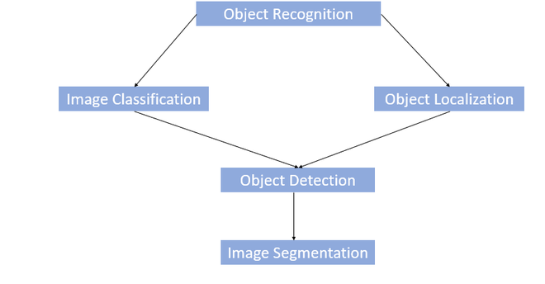

Slide 14
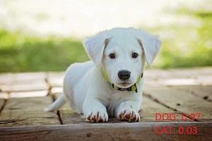
Image Classification :
In Image classification, it takes an image as an input and outputs the classification label of that image with some metric (probability, loss, accuracy, etc).
For Example: An image of a cat can be classified as a class label “cat” or an image of Dog can be classified as a class label “dog” with some probability.

Slide 15
Object Localization: This algorithm locates the presence of an object in the image and represents it with a bounding box. It takes an image as input and outputs the location of the bounding box in the form of (position, height, and width).
Object Detection:
Object Detection algorithms act as a combination of image classification and object localization. It takes an image as input and produces one or more bounding boxes with the class label attached to each bounding box. These algorithms are capable enough to deal with multi-class classification and localization as well as to deal with the objects with multiple occurrences.

Slide 16
Challenges of Object Detection:
In object detection, the bounding boxes are always rectangular. So, it does not help with determining the shape of objects if the object contains the curvature part.
Object detection cannot accurately estimate some measurements such as the area of an object, perimeter of an object from image.

Slide 17
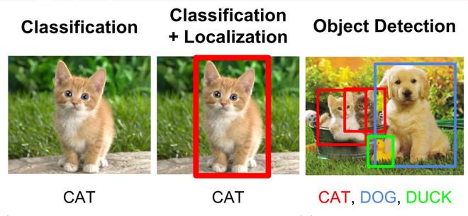

Slide 18
Image Segmentation:
Image segmentation is a further extension of object detection in which we mark the presence of an object through pixel-wise masks generated for each object in the image.
This technique is more granular than bounding box generation because this can helps us in determining the shape of each object present in the image.
This granularity helps us in various fields such as medical image processing, satellite imaging, etc. There are many image segmentation approaches proposed recently. One of the most popular is Mask R-CNN proposed by K He et al. in 2017.

Slide 19
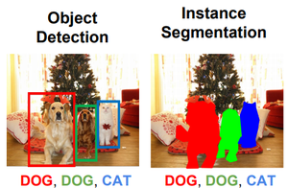

Slide 20
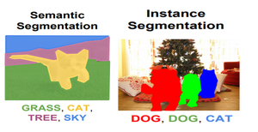
There are primarily two types of segmentation:
Instance Segmentation: Identifying the boundaries of the object and label their pixel with different colors.
Semantic Segmentation: Labeling each pixel in the image (including background) with different colors based on their category class or class label.

Slide 21
Applications:
The above-discussed object recognition techniques can be utilized in many fields such as:
Driver-less Cars: Object Recognition is used for detecting road signs, other vehicles, etc.
Medical Image Processing: Object Recognition and Image Processing techniques can help detect disease more accurately. For Example, Google AI for breast cancer detection detects more accurately than doctors.
Surveillance and Security: such as Face Recognition, Object Tracking, Activity Recognition, etc.

